Slide 1
Secure Data Hiding in Image Using Steganography
Presented By: Kathan Patel
Student Name : Patel Kathan Dipeshkumar
College Name & Department : SAL Institute of Technology & Engineering Research (Information & Communication Technology) ICT

Slide 2
OUTLINE
Problem Statement
Technology used
Wow factor
End users
Result
Conclusion
Git-hub Link
Future scope

Slide 3
Problem Statement
With increasing Cybercrimes in Cyber World, the traditional encryption methods make it easier decrypt the messages. So, Steganography provides an extra layer of security by encrypting the message into image, making them invisible to an attackers. This project implementing image-based steganography, let’s you hide the messages in plain sight, inside images, so only someone with the right password can unlock them.

Slide 4
Technology used
Python – Core programming language
String – To Create random password
OpenCV – For image processing & pixel manipulation
ASCII Encoding - To convert text into numerical values
File Handling – To store & validate passwords

Slide 5
Wow factors
Universal Compatibility: The system works with multiple image formats like JPEG,PNG,JPG & BMP gives user-friendly to choose whatever format of image for encryption.

Slide 6
End users
National Agencies –For secure governments policies or norms from attackers.
Military & Intelligence Agencies – For secure communication to agencies.
Corporate World – To send sensitive or confidential messages.
Students & Researchers – Learning Steganography concepts in cryptography.

Slide 7
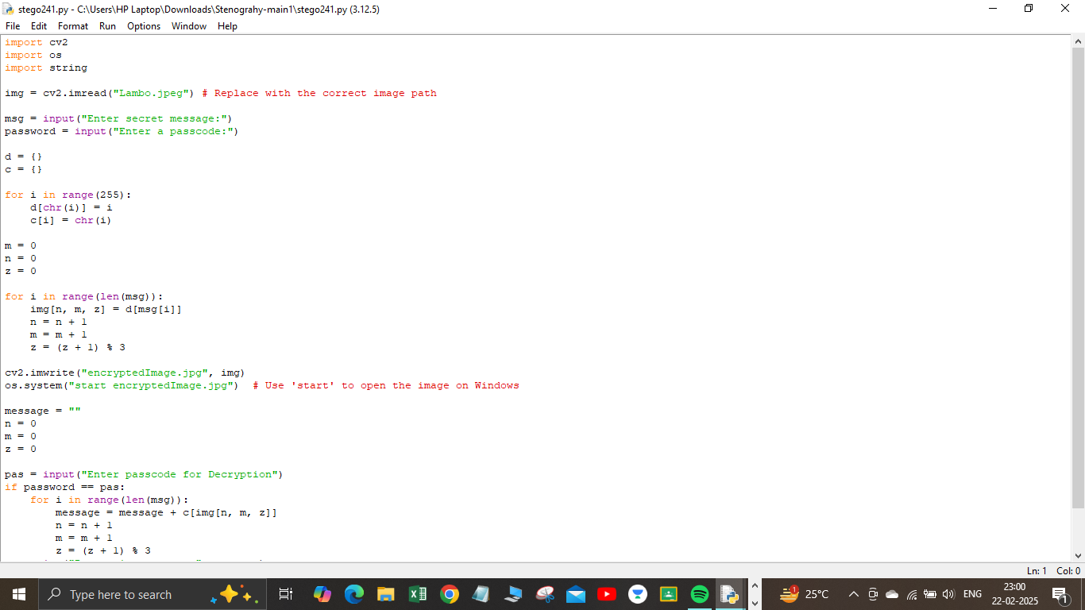
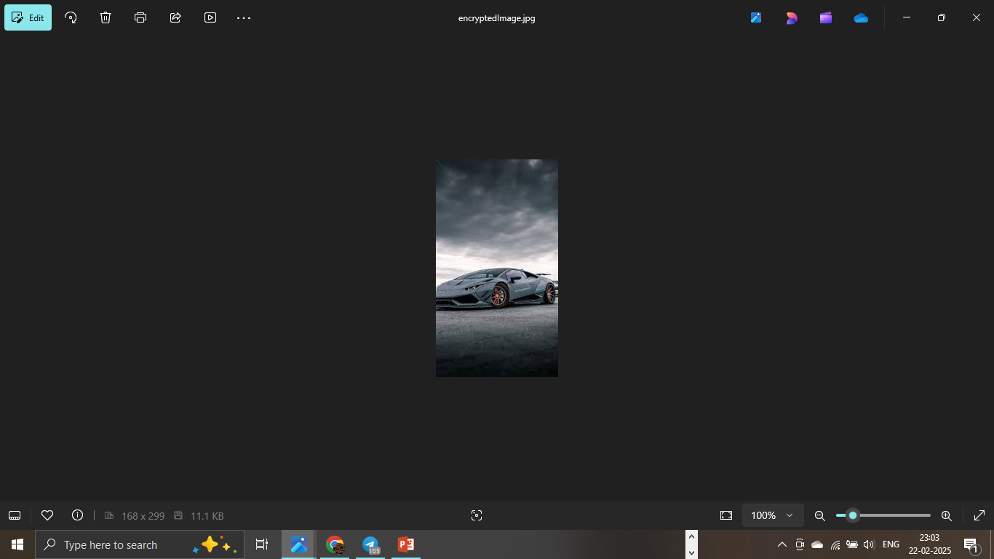
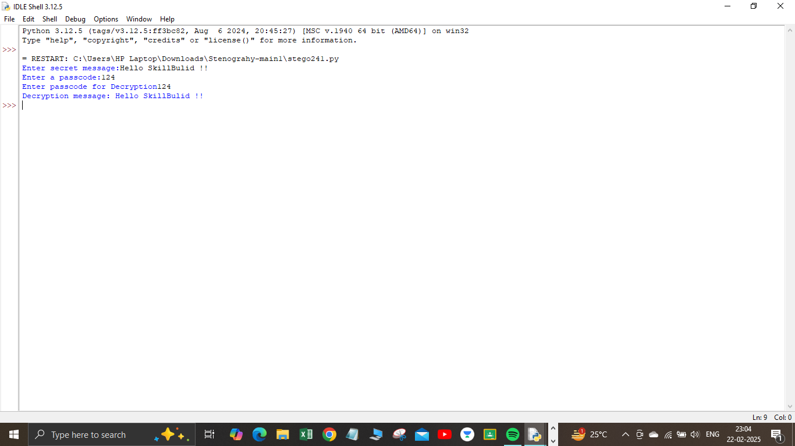
Results

Slide 8
Conclusion
This project successfully implements image-based steganography, by hiding yours messages within images, we’ve added a layer of invisibility that old traditional encryption can’t provide. For controls we can specify who can sees your secret messages by protecting through passwords.

Slide 9
GitHub Link
https://github.com/Kathanp241/Steganography_Project.git

Slide 10
Future scope(optional)
Stronger Encryption Methods: Before embedding the message, secure it with RSA or AES encryption, making it even more difficult to crack.
Mobile Application: Bring this Technology to smartphones, allowing users to hide & retrieve secret message.
Enhanced Security: Upgrade to advanced Least Significant Bit (LSB) steganography to make it nearly impossible for anyone to detect hidden messages.
Support for More Formats: expand compatibility to PNG, GIF, & BMP while ensuring that the image quality remains intact after encryption.

Slide 11
THANK YOU

